Slide 1
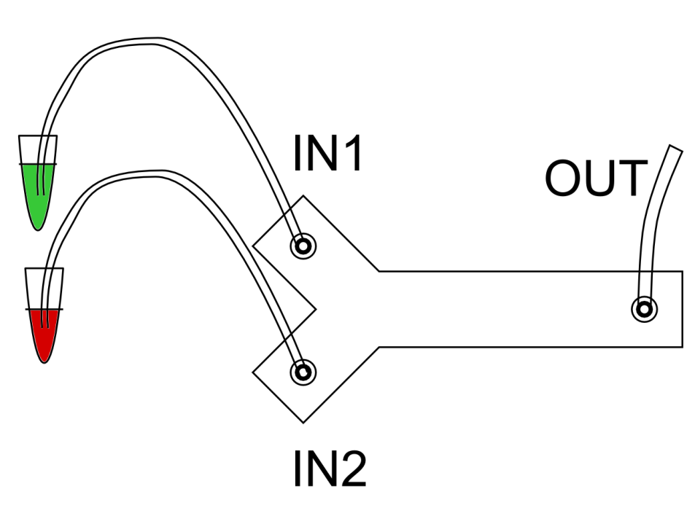
Flow chamber

Slide 2
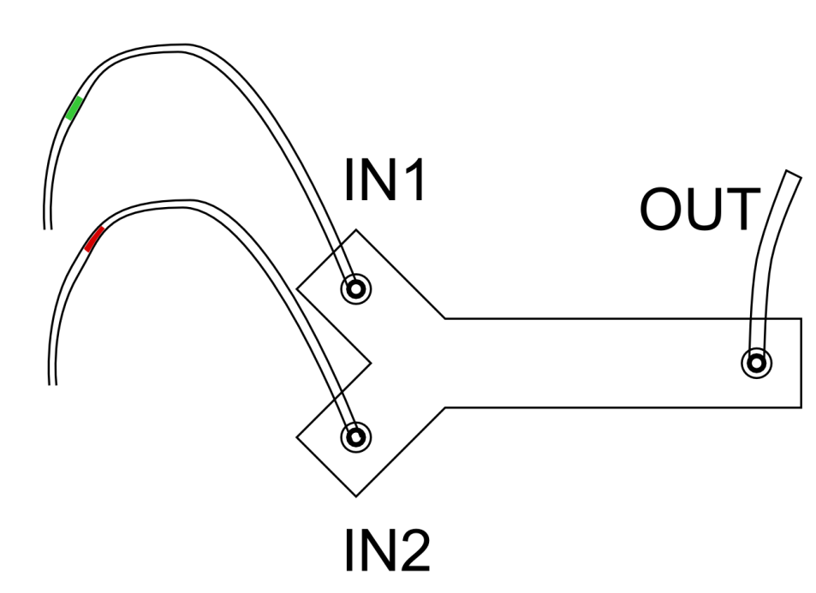
Flow chamber

Slide 3
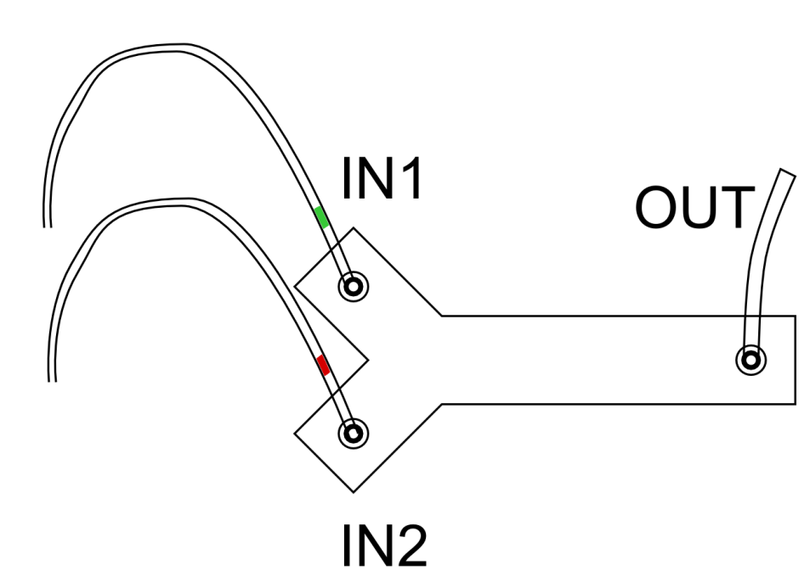
Flow chamber

Slide 4
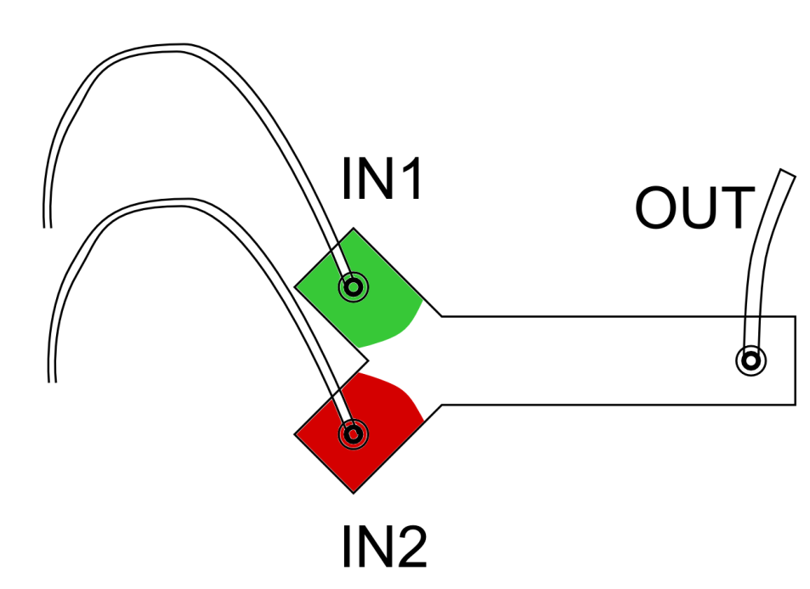
Flow chamber

Slide 5
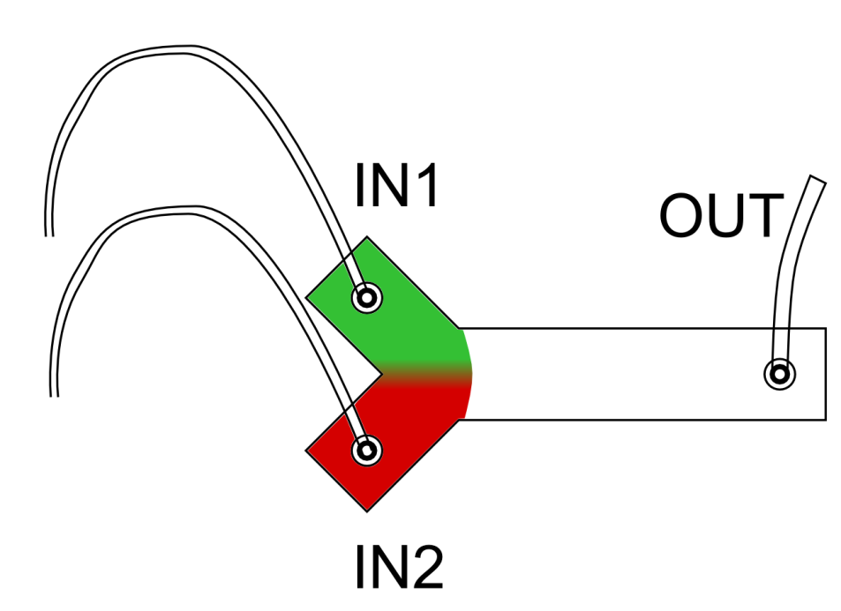
Flow chamber

Slide 6
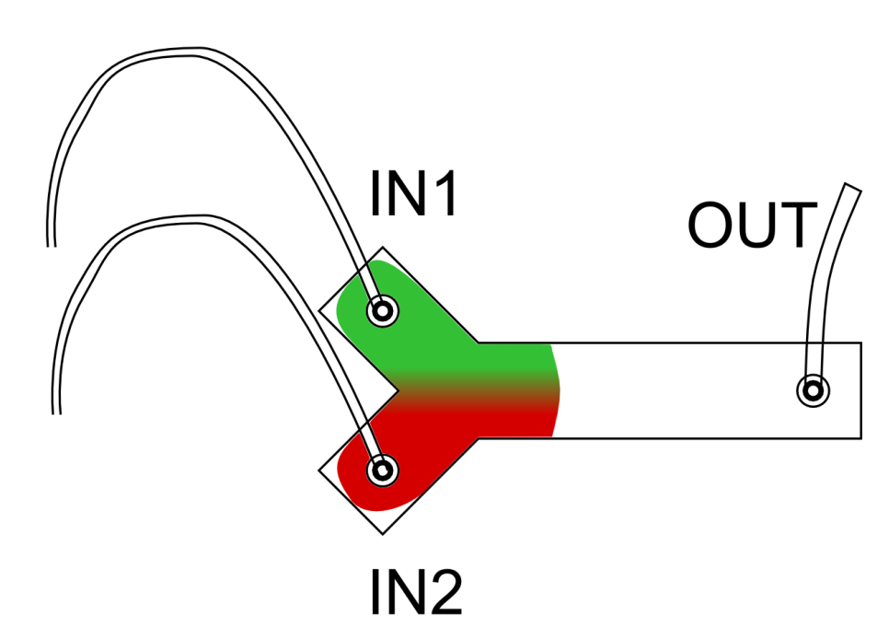
Flow chamber

Slide 7
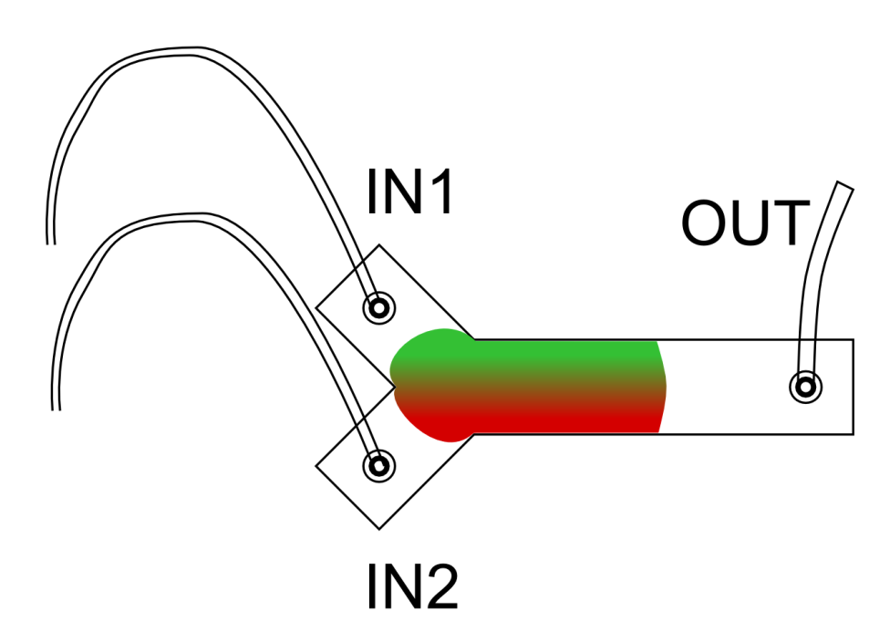
Flow chamber

Slide 8



Array configuration

Slide 9
Flow chamber
to pump
Specs
Sample volume: 20µl
Pump (suction):
Peristaltic (manual start/stop)
Syringe (manual and program)
Channel:
Width: 1mm
Height: 100µm
Caveat
Anti-sticking: tween added to buffer
Diffusion repeatability:
Repeat Step 1 multiple times to study variations
Time scale
1-30s with 1s resolution
Step 1
Probe + buffer (high FRET)
Wash both channels with buffer
Step 2
Probe + comp. strand (low FRET)
Wash with buffer

Slide 10
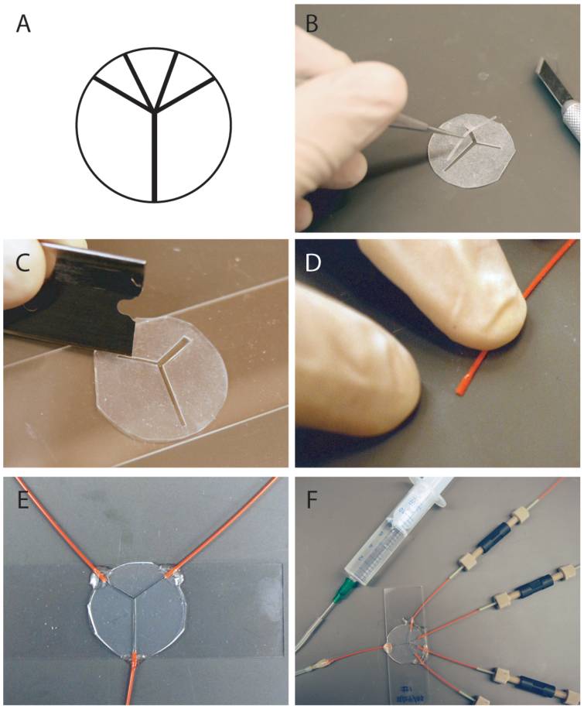
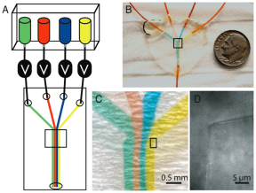
Flow chamber building protocol
Courson DS, Rock RS (2009) Fast Benchtop Fabrication of Laminar Flow Chambers for Advanced Microscopy Techniques. PLoS ONE 4(8)

Slide 11
Preliminary experiments
First crude flow chamber built
Tested with peristaltic pump
Results
Sample does not flow evenly in the two channels
Flow is not uniform (in time)

Slide 12
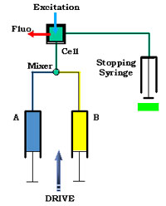
Stop flow approach
Pump
INPUT: Syringe-pump
The flow is forced to be the same on both channels
OUTPUT:
Stopping syringe fixes the volume
Mixer
T-junction
“arrow” junction
Problems
High volume 500µL

Slide 13
Minimize the sample volume
Syringe sample
Syringe buffer
Samples
Push
Fixed
Buffer
Buffer
Syringe sample
Syringe buffer
Fixed
Push
Flow
chamber

Slide 14
What we want to investigate?
Dynamics of short dsDNA hybridization in freely diffusing conditions
Since the sample is freely diffusing we necessary have a mixing phase
The mix phase can be fully characterized (time-constant, variability)
We measure a process transient: high FRET to low FRET
If no difference in transient:
the process is diffusion limited (if D=const. the speed does not change)
If big difference in transient:
the process is driven by hybridization dynamics
Otherwise:
the process is regulated by both diffusion and hybridization dynamics

